Slide 1
Introduction to POWER BI
PRESENTED BY – REMYA R S

Slide 2
data
Data is a collection of various facts, such as measurements, observations, and figures, that have been transformed into a language that computers can understand.
Importance of data
Understanding problems and positions of organization / people
Understanding needs of an organization or people
Knowing nature of customer, employee, market etc….
Decision Making
Solving real world problems
Improving process(fast and less expensive)
Keep track of all
Best utilization of resources available
Finding performance of a company or group of people

Slide 3
Roles in Data
Data Administrator
They figures out which data is relevant to be stored in data models. Its is less of a technical role and more of a business role with some technical knowledge.
Data Engineer
Manages secured flow of structured and unstructured data from multiple sources.
Data Analyst
Responsible for capturing,cleaning, modifying and transforming data and creating dashboards and reports, using visualization tools.
Business Analyst
Interprets business data that comes from visualization. He knows pulse of business unlike data analyst.
Data Scientist
Performs advanced analytics that business analyst can’t do and extracts value from data. Provides valuable insights using advanced mathematics and technologies like machine learning, deep learning

Slide 4
Business Intelligence
Need
Collection
Analyze
Visualize
Decision

Slide 5
Business Intelligence
Business intelligence (BI) refers to a collection of procedures, frameworks, and tools that transform unprocessed data into actionable knowledge that helps businesses operate profitably.
BI encourages the use of historical data to assist fact-based decision making rather than assumptions and intuition.
In order to give users in-depth insight about the nature of the business, BI tools analyze data and produce reports, summaries, dashboards, maps, graphs, and charts.

Slide 6
Importance of Business Intelligence
Creating KPIs (Key Performance Indicators) based on historical data
Determine and establish standards for various procedures.
Businesses can notice issues that need to be resolved by using BI systems to identify market trends.
Data visualization, which is aided by BI, improves data quality and, as a result, decision-making quality.

Slide 7
Advantages of using BI tools
Businesses may generate reports with only one click, which saves a ton of time and resources. Additionally, it enables workers to complete their responsibilities more effectively.
BI aids in locating any company areas that require attention.
Through common BI features like dashboards and scorecards, BI systems also assist organizations' decision-makers in gaining a broad perspective.
By providing predictive analysis, computer modeling, benchmarking, and other approaches, it also automates analytics.
It enables users, regardless of technical or analytical background, to swiftly gather and process data. This makes it possible for many people to access the power of analytics.

Slide 8
Disadvantages of using BI tools
For many small and medium-sized businesses, BI systems are still out of reach and costly.
Business practices may become stiff when dealing with it because it can be so complex.
Data warehousing system implementation takes almost one and a half years to complete. Due to this, the process takes a long time.

Slide 9
Gartner Magic Quadrant
Gartner's IT consulting company produces a series of market research studies called Magic Quadrant (MQ) that use exclusive qualitative data analysis techniques to show industry trends like direction, maturity, and participation. Their studies are carried out for several distinct technology businesses, and they are updated every one to two years.
Vendors are rated by Gartner based on : completeness of vision and ability to execute.
Completeness of vision - The completeness of the vision reflects the originality and innovation of the seller and if the vendor is leading or following the market.
Ability to Execute - Highlights elements including the vendor's financial stability, responsiveness to the market, product development, sales channels, and client base.

Slide 10
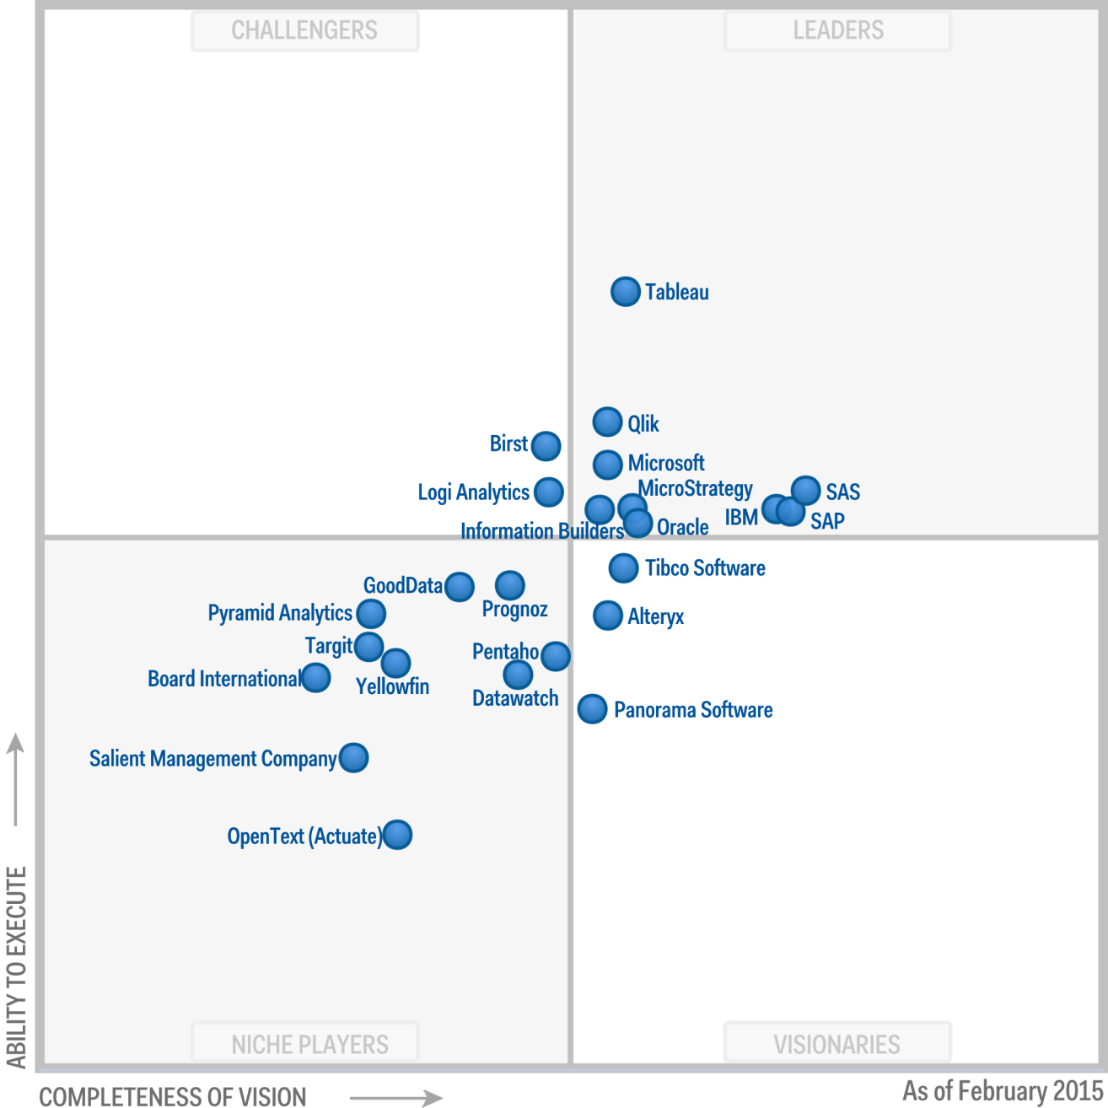
BI tools in 2015

Slide 11
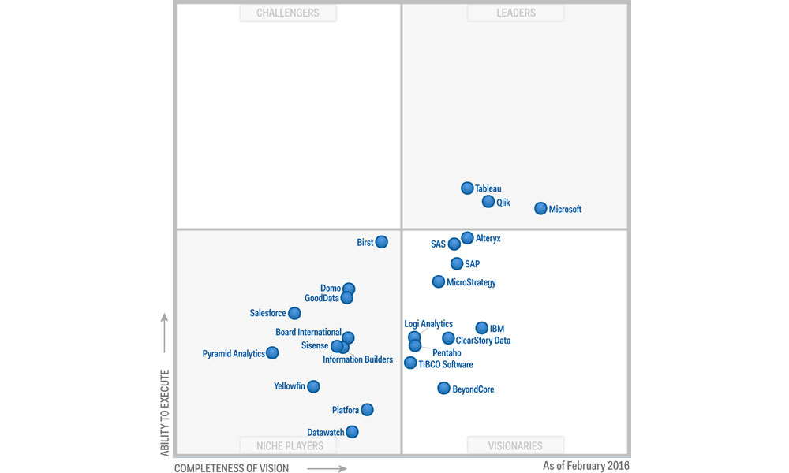
BI tools in 2016

Slide 12

BI tools in 2017

Slide 13
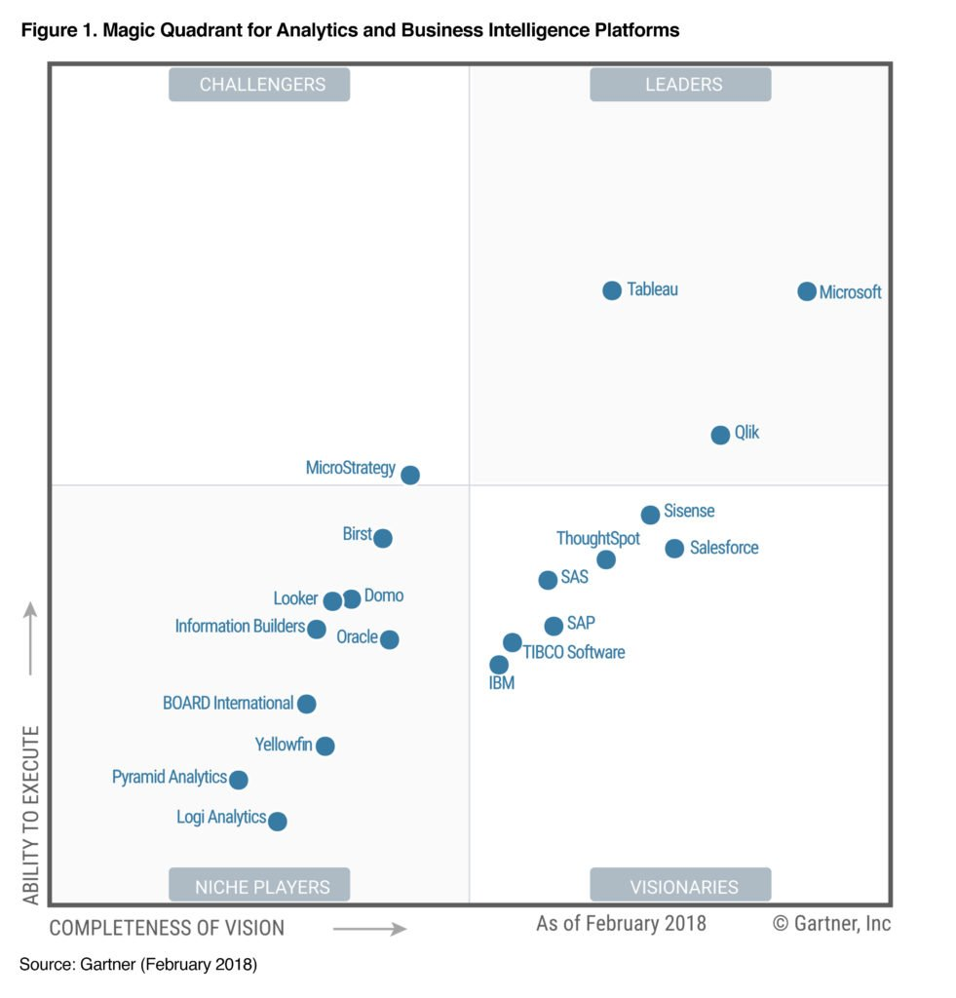
BI tools in 2018

Slide 14

BI tools in 2019

Slide 15

BI tools in 2020

Slide 16
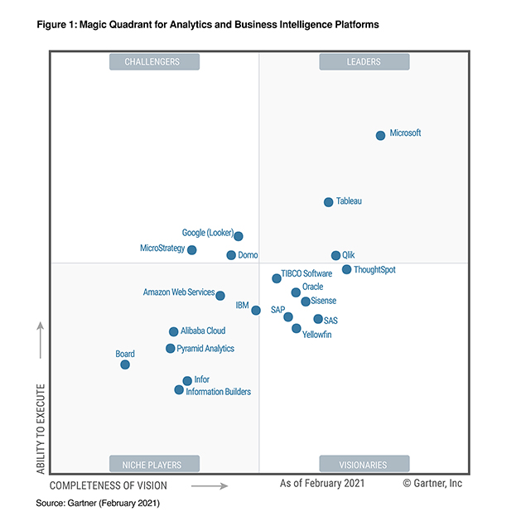
BI tools in 2021

Slide 17

BI tools in 2022
Power BI has been recognized by Gartner as the market's most complete and potent platform for the fourth year in a row.

Slide 18
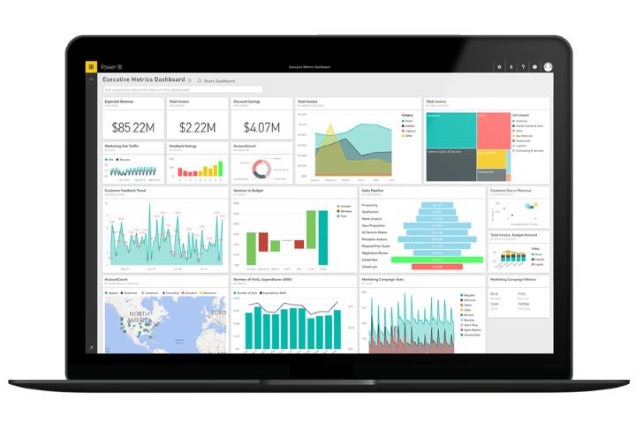
Power BI
Power BI – Business intelligence tool, used to clean and convert data into visualization format like dashboards and reports
Its business analytics service provided by Microsoft
Power BI Desktop - Application where we do visualization
Power BI tools
Power Query – Cleans data
Power Pivot – Data modelling, create relation between multiple data sources
Power View – To create 250 + charts
Power BI Service – To share files and dashboards

Slide 19
Working with PBI Step by Step
Power Query
Formula Bar
Power BI Service
Extract
Transform
Load
Data Modelling
DAX
Report Building
Publish Report
Dashboard Creation
Share & Create
Power Pivot
Power View
Power BI Desktop
Power BI Service

Slide 20
Job roles in Power BI & corresponding Average Salary
Power BI Manager - ₹ 21.5 Lakhs
Power BI Project Manager - ₹ 14.1 Lakhs
Power BI Administrator - ₹ 8.6 Lakhs
Power BI Consultant - ₹ 6.3 Lakhs
Power BI Semantic Model Developer - ₹ 5.9 Lakhs
Power BI Developer - ₹ 5.8 Lakhs
Data Analyst - ₹ 4.3 Lakhs

Slide 21
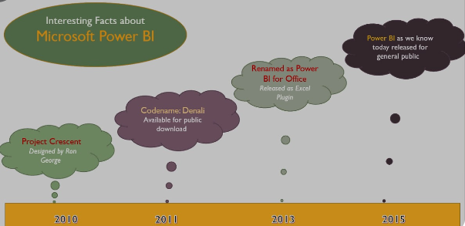
facts
It was originally designed by Ron George in the summer of 2010 and named Project Crescent.

Slide 22
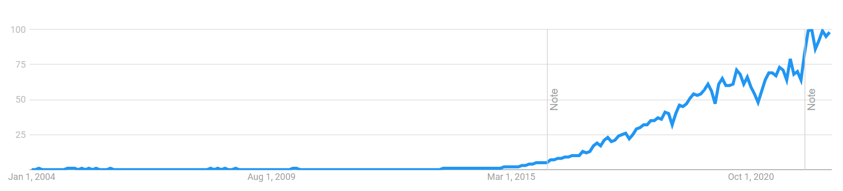
other Important points of power bi
1200 different functions available
280 visuals
Least expensive compared to other BI tools
Can accept data from 100 different data sources
Recognized by Gartner Company (which compares all BI products)

